Slide 1
COD-A-FESTX 2.0
Team karon
Problem Statement Title – “Automated News Article Summarization System in Python “
Team ID – 33
Team Name – Karon

Slide 2
IDEA TITLE
Team karon
Objective:
The solution automatically summarizes news articles by fetching and processing content either from directly pasted text or uploaded PDFs, providing concise summaries to help users quickly understand the main points.
How It Addresses the Problem:
Time Efficiency: The solution saves users time by generating concise summaries, allowing them to grasp key information without reading the entire article or document.
Versatile Input: It accepts content from multiple sources, including pasted text and uploaded PDFs, making it flexible for different user needs.
Simplified Understanding: By extracting the most relevant sentences, it reduces information overload and presents the essential points clearly.
Accessible and User-Friendly: The system provides an easy-to-use interface, streamlining the process of summarizing articles or documents for users.

Slide 3
Technologies to Be Used
Team karon
Programming Languages:
Python: The primary language for developing the summarization system due to its extensive libraries and ease of use for text processing.
Libraries :
Flask: Web framework for building APIs.
Flask-CORS: Enables cross-origin requests (e.g., React frontend).
Transformers: Provides pre-trained models (used for text summarization).
PyPDF2: Extracts text from PDF files.
io: Handles file streams (optional for advanced file handling).
React : I created a frontend using React, a JavaScript library for building fast, interactive user interfaces, which communicates with the Flask backend for text and PDF summarization.

Slide 4
Team karon
Innovation and Uniqueness:
Web-Based Interface: Flask provides a user-friendly interface for summarizing news articles, PDFs, and text files.
Multi-Format Support: Handles different input formats (news articles, PDFs, plain text) and generates summaries accordingly.
Integrated Tools: Combines newspaper3k for news articles, sumy's LSA for summarization, pypdf for PDF extraction, and Flask for web deployment.
Advanced Summarization: Uses LSA to ensure contextually relevant summaries across different formats.
Modular and Scalable: Easily adaptable to include additional features or enhancements.

Slide 5
FEASIBILITY AND VIABILITY
Team karon
Technical Feasibility:
Tools: newspaper3k, pypdf, transformers , Flask are compatible and well-documented.
Performance: Suitable for typical use; large files or high traffic may need optimization.
Challenges & Risks:
Accuracy: Extracting text from PDFs and complex pages may be imperfect.
Performance: Large documents or high traffic could slow down the system.
Security: Handling user inputs requires careful security measures.
Strategies:
Accuracy: Use multiple extraction tools and preprocess text.
Performance: Optimize code and use caching/load balancing.
Security: Sanitize inputs and use secure connections (HTTPS).

Slide 6
IMPACT AND BENEFITS
Team karon
Potential Impact:
Target Audience: Time-strapped individuals, researchers, and professionals seeking quick summaries of lengthy articles and PDFs.
Accessibility: Simplifies access to information, allowing users to grasp key points quickly.
Benefits:
Social: Enhances productivity by providing quick, concise summaries, reducing information overload.
Economic: Saves time for businesses and individuals, boosting efficiency in content consumption.
Environmental: Reduces paper use by promoting digital summaries over printed materials.

Slide 7
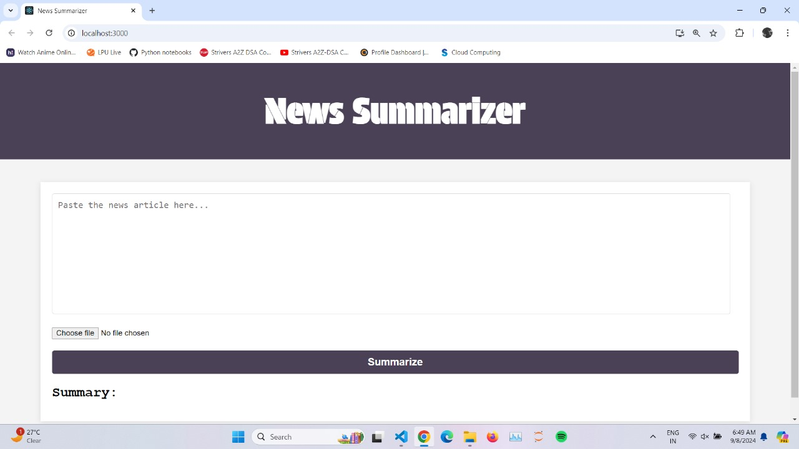
User Interface

Slide 8
RESEARCH AND REFERENCES
Team karon
https://stackoverflow.com/
https://www.tensorflow.org/
Git hub - https://github.com/rHarsh-11/Automated-News-Summarization-System

